Slide 1
Lecture 1: Introduction
USC VSoE CSCI 544: Applied Natural Language Processing
Jonathan May -- 梅約納
August 23, 2017
Most slides from Noah Smith

Slide 2
{Mandarin Chinese, English, Spanish, Hindi, ..., Uyghur, ..., Oromo ...}
Anybody speak a rare language?

Slide 4
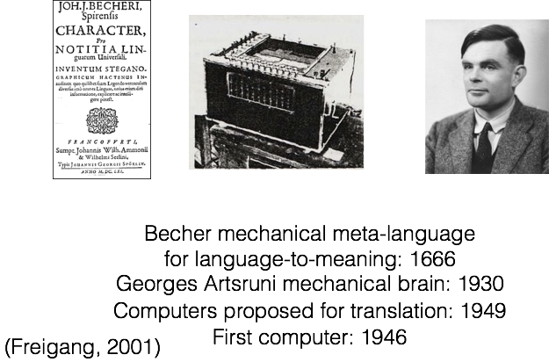
NLP is a pretty old topic!
ACL founded : 1962
Jon first heard about NLP : 1999
Gainfully employed since 2001
(USC PhD 2004-2010)

Slide 5
WHY?

Slide 6
February 2011

Slide 7
October 2011

Slide 8
Launched 2006
App 2011
WordLens 2015

Slide 9
Where else have you seen NLP in your life,
in the news, or elsewhere?

Slide 10
, plagiarism detection (WARNING)
What tasks do you want to accomplish?

Slide 11
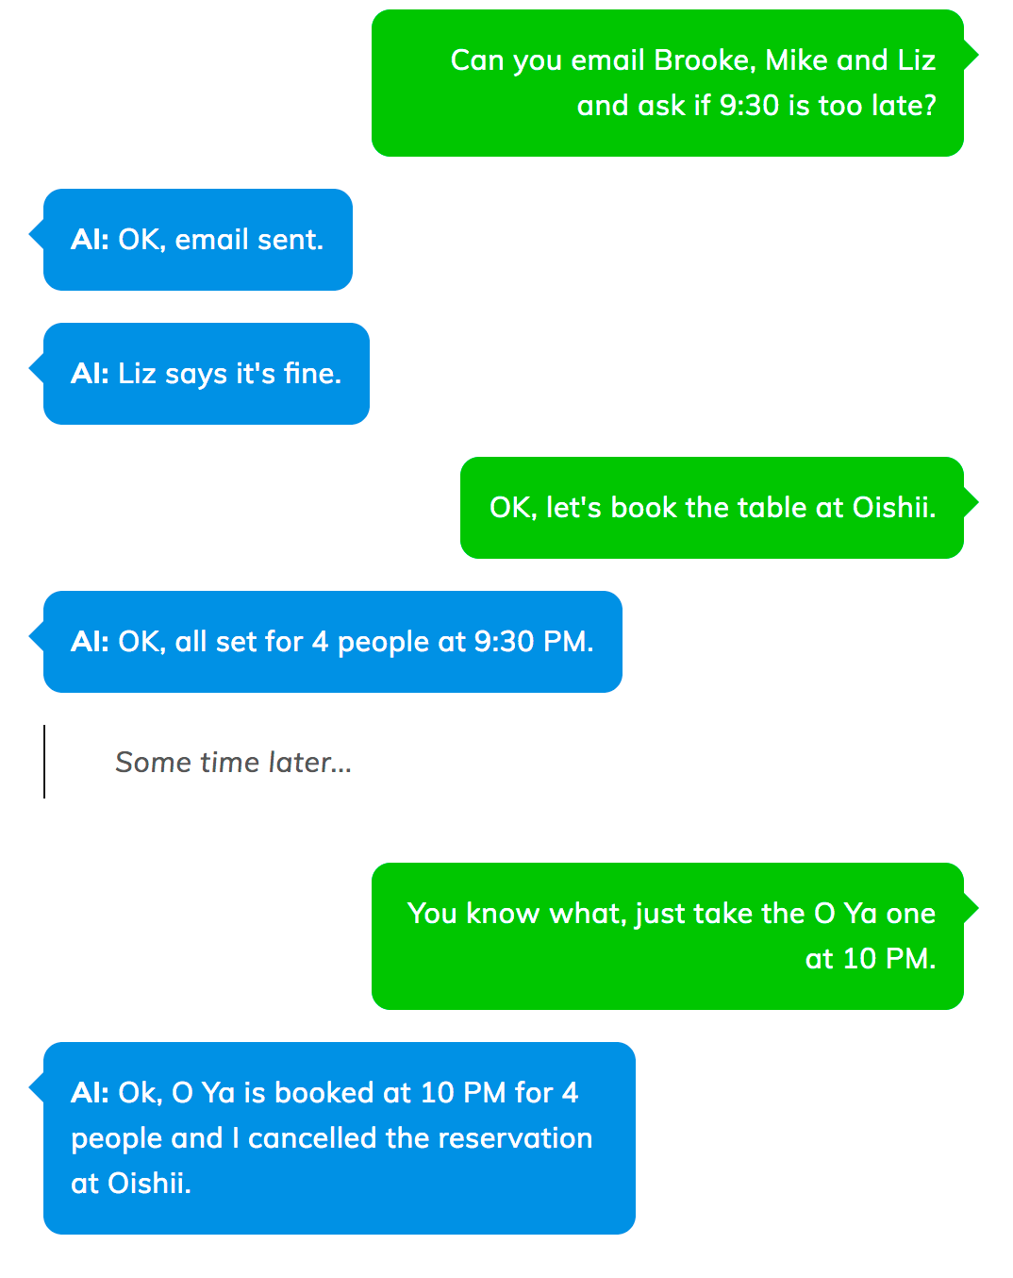
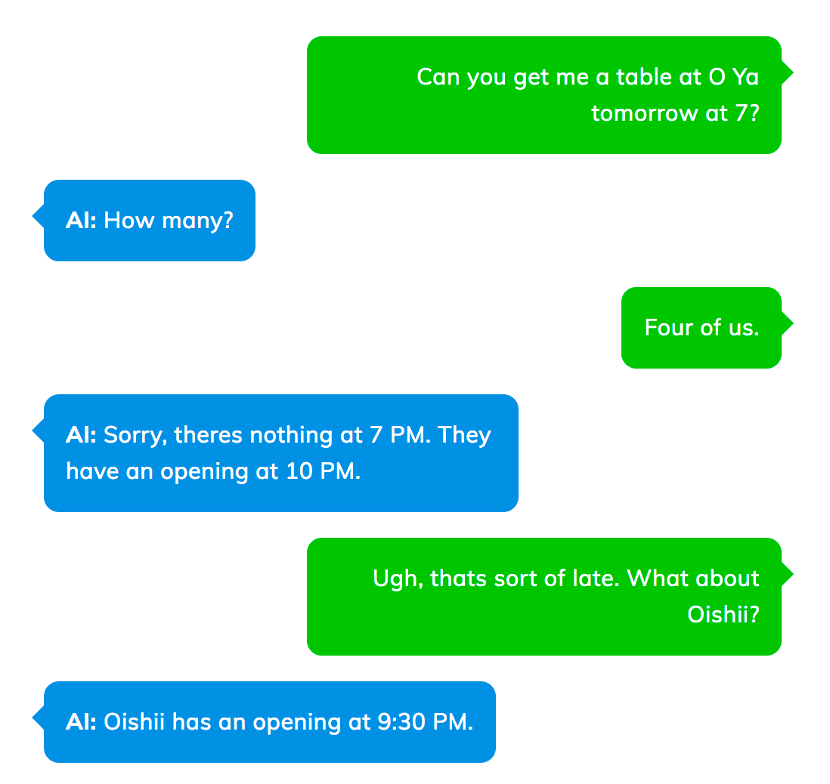
NLP of the (near) future
Ambiguity Resolution
Information Retrieval/Question Answering
Grounding
Summarization
Word Sense Disambiguation
Generation
Coreference
Resolution
Named Entity Recognition
Spelling correction
Translation (If we were in Osaka)
h/t Semantic Machines

Slide 12
NLP of the (near) future
Ambiguity Resolution
Grounding
Summarization
Information Retrieval/Question Answering
Named Entity Recognition
Spelling correction
h/t Semantic Machines

Slide 13
How do we (humans) do these tasks?
Spelling Correction
Named Entity Extraction
Question Answering
Coreference Resolution
Grounding
Ambiguity Resolution
Summarization
Translation
Long story short, you know languages!

Slide 14
What does it mean to "know" a language?
(What is the "true" R?)
Do I know English?
Do I know Mandarin?
Does a toddler know English?
Does wc know English?

Slide 15
low
ambiguity
high

Slide 16
phones = distinct sounds
(governed by anatomy)
low
/l/ = alveolar lateral approximant lace
/ɾ/ = alveolar tap race
/r/ = alveolar trill rey (sp.)
phonemes = meaningfully
distinct sounds
(governed by language)
ambiguity
English: /ɾ/ vs /r/ conflated
Japanese: /ɾ/ vs /r/ vs /l/ conflated
Hindi: /d̪/ vs /d̪ʱ/ distinct
Chinese: ma1 vs ma2 vs ma3 distinct
high

Slide 17
low
ambiguity
ሚስተር ቤንጀሚን መንግስቶም ንትግባረ’ቲ ሰነድ ሰላም ዝከአሎ ከምዝገበረ ንህዝቢ ደቡብ ሱዳንን ማሕበረ-ሰብ ዓለምን ዘርእየሉ ወቅቲ ኢና ንርከብ'ውን ኢሎም።
high

Slide 18
low
ambiguity
high

Slide 19
low
ambiguity
high

Slide 20
talk +s (present, 3rd person sing.)
talk +ed (past)
low
other languages with more morphology?
ambiguity
unfriend, Obamacare
high

Slide 21
What is a word?
single unit of meaning?
low
text separated by whitespace?
We have to make decisions!
Thai (or Chinese) example?
ambiguity
Turkish example?
non-compositional multi-word expressions: New York, take out
high

Slide 22
How do words fit together?
DT
JJ
NN
the
blue
boat
low
NN
JJ
DT
boat
blue
the
S
ambiguity
NP
VP
the blue boat
sailed home
high
Note similarity to programming languages!

Slide 23
What does a sentence mean?
The soldier did not want to die.
low
polarity
negative
want-01
agent
result
ambiguity
agent
soldier
die-01
want-01: "desire"
(not "lack")
high
die-01: "cease to live"
(not "want very much")

Slide 24
low
What does the speaker mean?
Can you get me a table at O Ya?
ambiguity
Yes, I have the ability to book reservations.
high

Slide 25
low
What are the goals of the participants?
Can you get me a table at O Ya?
ambiguity
Would you like a wood or steel table?
Maybe many people,
long period of time...
high

Slide 26
Ambiguity makes NLP hard
meaning of bank or mean or latex
make a decision or take out or make up
And Funny!
Enraged Cow Injures Farmer with Ax
Ban on Nude Dancing on Governor's Desk
Teacher Strikes Idle Kids
Hospitals are Sued by 7 Foot Doctors
Iraqi Head Seeks Arms
Stolen Painting Found by Tree
Kids Make Nutritious Snacks
Local HS Dropouts Cut in Half
h/t Dan Klein

Slide 27
Syntax + Semantics
We saw the woman with the telescope wrapped in paper.
Who has the telescope?
What is the paper wrapping?
An event of perception or an assault?
Humans have one (or two) major readings of this;
hard to keep computers from getting the unlikely ones

Slide 28
Semantics
Every fifteen minutes a woman in this country gives birth.
Our job is to find this woman, and stop her!
-- Groucho Marx

Slide 29
Richness makes NLP Hard!
Lots of ways to express the same thing
Sometimes people communicate in an intentionally ambiguous way
There are many languages, styles, genres, modalities...
The soldier was not afraid to die
?
The soldier did not fear death
=
How many other ways can this be said?
"u ship them? smh." "ikr, lolol, yolo."
"Call me at six niner i three triple 0 dos"
"14 words now and then sure 88 later if u want"

Slide 30
Uncertainty/Noise Propagated at Scale Makes NLP Hard!
Lots of ambiguity at every level from one string!

Slide 31
Representation makes NLP Hard!
what is the meaning in these cases?
more than just meaning is represented in these
communications
What is the "real" R?

Slide 32
How can we evaluate some of the tasks proposed?

Slide 35
People from other fields!
Why are you here?

Slide 38
What You Will Learn In This Course (I hope)
How the NLP you interact with on a daily basis works
The various models, algorithms, and tools that are out there to solve language-related problems you want to tackle
How to design and evaluate your own task/model/algorithm/tool
The currently open research questions, so you can pursue further study

Slide 39
Questions about Intro?
Next is Boring Course Stuff That Is Very Important

Slide 40
The Team
Jon (instructor)
Asst rsrch prof since 2015, USC PhD 2010, worked in NLP since 2001, MT, IE, Semantics, ML
I spend most of my time at ISI in Marina del Rey
Ramesh Manuvinakurike (TA)
PhD student since 2013 at ICT studying dialogue systems
Siddharth Jain (TA)
PhD student since 2012 at ICT studying
Dong Guo (TA)
PhD student (ML), dialogue/QA industry experience
Sneha Salvi (Grader)
Xiang Zhang (Grader)

Slide 41
Support
DO NOT EMAIL US (sorry)
Piazza Discussion Forums
TAs and Instructor will monitor regularly, answer questions, engage in discussion
You should answer each others' questions and help your fellow students out!
Outstanding student contributors will receive a grade bump-up as extra credit (e.g. B to B+, B+ to A-) [see extra credit details in 4 slides]
Office Hours
Jon: 10am-11am Wed & Fri (i.e. after class), RTH 512; 11am-12pm possible if there is demand
Siddharth 8am-10am Mon, SAL lab
Dong 12pm-2pm Tue, EEB 220
Ramesh 8am-10am Thu, SAL lab

Slide 42
Syllabus and Schedule
go to "jonmay.net" and click on the link for the class website
Schedule will probably change depending on our speed; check back frequently
No official textbook; readings will be posted on the class website/Blackboard
Class through 12/1 except:
Fri, 9/22 No Class (Instructor religious holiday)
Fri, 10/6 MIDTERM (note: see me after class if you have religious holiday)
Week of 11/22, 11/24 No Class (Thanksgiving)

Slide 43
Lecture and Notes
You don't have to come to class if you don't want to/can't
If you do, please pay attention and participate!
However you are responsible for everything covered in class, and
It won't be recorded
Slides may not cover everything I discuss
Slides will be posted soon after class
I use a lot of slides from other classes and note this; feel free to self educate. In particular check out videos from:
Noah Smith (Univ. Washington)
Adam Lopez (Univ. Edinburgh)
Dan Jurafsky (Stanford)

Slide 44
Prerequisites
I expect you to program at the level of a CS undergrad senior or better
Most of the assignments will be in Python
There will be basic probability and statistics, which will be reviewed as needed

Slide 45
Homeworks
8 homeworks, 2 weeks to do each one, they overlap (i.e. you will receive hw2 before hw1 is due; cf. syllabus). 7.5% of your grade each.
No homework will be assigned or due right before midterm/final
Mostly programming assignments submitted to Vocareum (you should have received an email opening your account, let us know if not!)
Some written assignments submitted electronically
You can have 4 late days total over the whole course...
...but no more than 2 per assignment
Late homeworks thereafter are penalized by 50% for the next 24 hours, then not accepted

Slide 46
Exams
Midterm: October 6 (please notify me if it's a religious holiday ASAP)
15% of grade
short answers, maybe multiple choice, some derivations, some pencil & paper calculations
one double-sided page of notes allowed (may be prepared with other current 544 students)
Final: December 6, 8-10am
25% of grade
like the midterm, but can cover the whole class (emphasis will be on second half)
one double-sided page of notes allowed (may be prepared with other current 544 students)

Slide 47
Extra Credit
Outstanding forum contributors may have their grade bumped a category (e.g. B- to B, B+ to A-).
The number of and determination of such contributors is up to the staff and is not eligible for regrade.
Occasionally there may be extra credit points in a homework. These will offset other point losses in that homework (i.e. they do not affect other homeworks/exams and cannot result in a >100% score).

Slide 48
Grading/Regrading Policy
Grades will be issued one week after the exam/homework.
No changes are allowed to submitted homework (after the deadline)
If something is clearly wrong, you may request specific regrade of a specific question/part via a google form the TAs will send out.
WARNING: If you are just 'fishing' for points you may LOSE additional points. No grubs!

Slide 49
Cheating
You MAY
talk with other students, friends, or others about your homework assignments IF you acknowledge such discussion in your submission
ask questions about the homework and subject material in the forums
You MAY NOT
copy code or answers from any source including friends, homework/test services, NLP or other software libraries. This includes making slight changes to previously written code
hack the scoring servers, Kobiyashi Maru-style
allow your code to be copied, even if unintentionally
attempt to communicate with or read from any other person while taking exams

Slide 50
Cheating
Unfortunately, about 20 of you will be caught cheating, based on previous experience.
By the end of this course you should have a pretty good idea of how we do it! (Hint: We use NLP to do it)
Suspected cheats (including those who were plagiarized from) will be reported to the University. Punishment includes but is not limited to:
zero on assignment, exam, or class
Loss of career services privileges
Loss of CPT rights
Uncomfortable meeting with Lizsl

Slide 51
Next This Time...
Corpora and Text Processing
Bring a laptop; we'll do in-class data manipulation, minor coding
Make sure you have been invited and can get into vocareum/piazza

